Slide 1
06 -- DWH and Reports

Slide 2
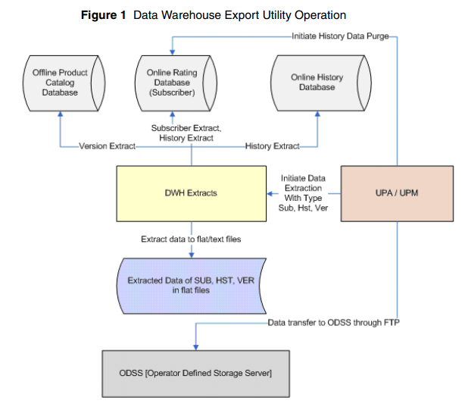
Data Extraction
The Comverse ONE-RT includes the utility for Data Extraction to external Reporting/Data warehouse system

Slide 3
Data Extraction -- Continue
The data extraction for VNP project will include the following history related information
CALL_HISTORY
RECHARGE_HISTORY
MTR_HISTORY (MONETARY TRANSFER RECORD)
DIAMETER_HISTORY
SUBS_OFFERS_HISTORY
These information can be used for reporting and analytics purpose.

Slide 4
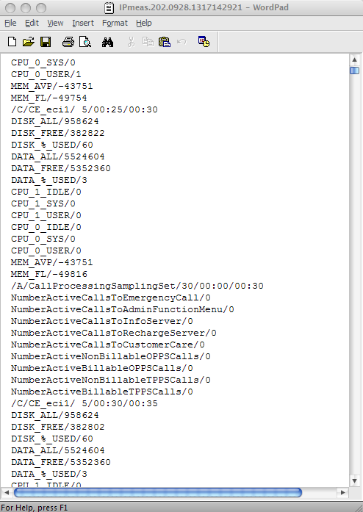
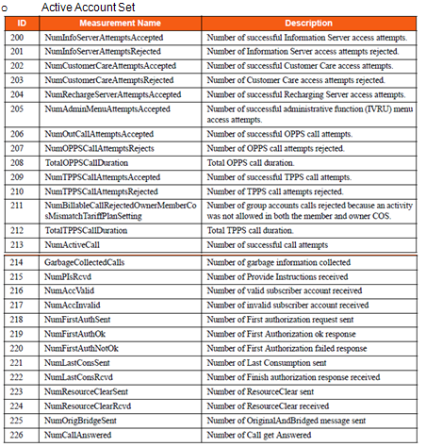
Platform measurement
The Comverse ONE-RT includes the utility to generate the System statistics of system components. This information will be used by traffic engineering to analyze the system performance
The platform statistics data for all system components can be retrieve from UPM. There is one platform measure per system component per day.
Service statistics are measurements generated by the SLUs on the performance of Comverse ONE solution. Service statistics are grouped in the following sets:
Active Account Set
Recharge Server Set
USSD Set
CAP3-SMS Set
CAP3-GPRS Set
Number Portability Query (NPQ) Set
Diameter Set

Slide 5
Thank you

